Slide 1
House Price Prediction

Slide 2
Content list
Introduction
Scope and Objective
Literature Review
Data Exploration and Visualization
Tools and Techniques
Model Training and Evaluation
Results
Conclusion
References

Slide 3
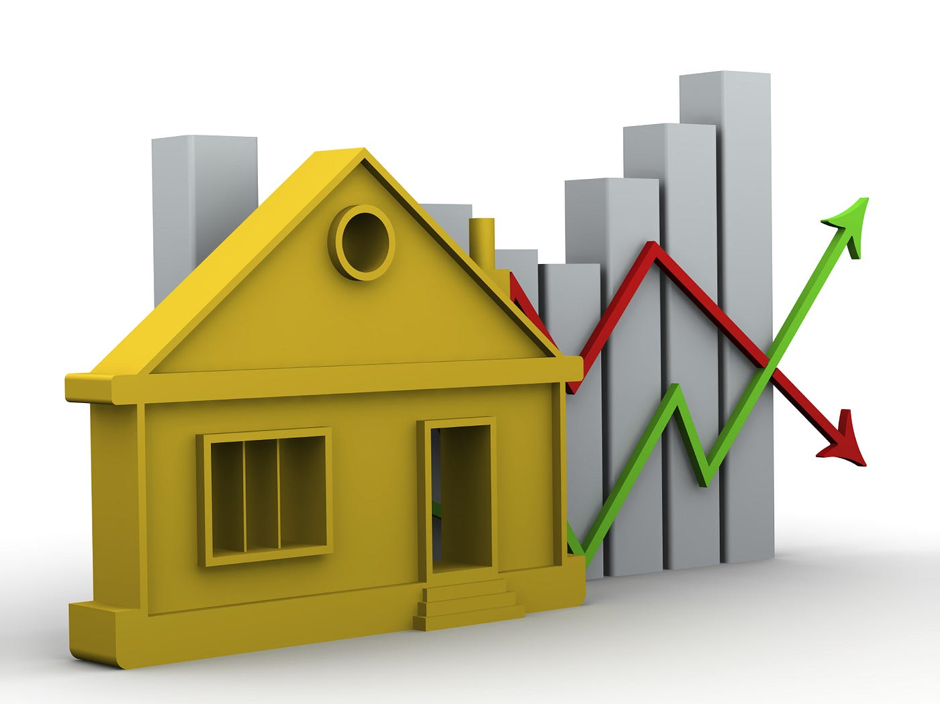
Introduction
Integration of machine learning into business
Data driven decision-making
Significance of accurate house price predictions
Practical application of ML in real estate market using neural networks

Slide 4
Scope and Objectives
Scope
Using ML, specifically Neural Networks to predict house prices by using the variety of property features.
Show how data analytics can be used to solve real-world problems.
Objectives
Develop a Predictive Model
Improve Real Estate Investment Decisions
Aiming Market Transparency
Upskilling MBA Candidates

Slide 5
Literature Review
“Real Estate Market Analysis” -- Medium
“Technology is poised to Upend America’s Property Market” -- The Economist
“Should you put money into a house you’re planning to sell?” – The New York Times
“House Price Prediction” -- Academia
“House Price Prediction: A Data Science Project Guide” – Medium
Cohesive Analysis
Transforming potential of machine learning in house price predictions and the real estate industry.

Slide 6
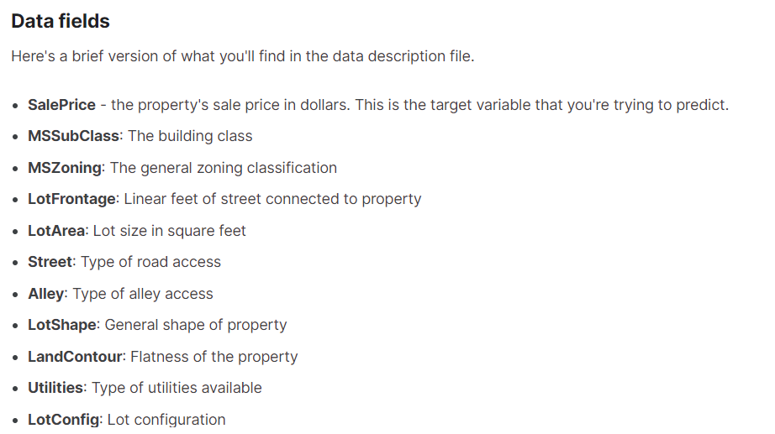
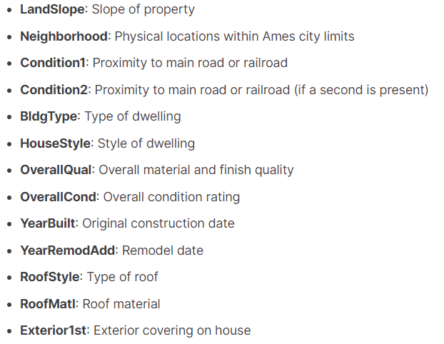
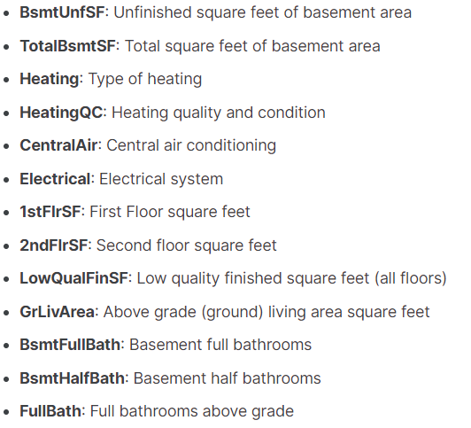
Data Exploration and Visualization
Dataset Source -- House Prices dataset from kaggle
https://www.kaggle.com/datasets/lespin/house-prices-dataset?resource=download

Slide 7
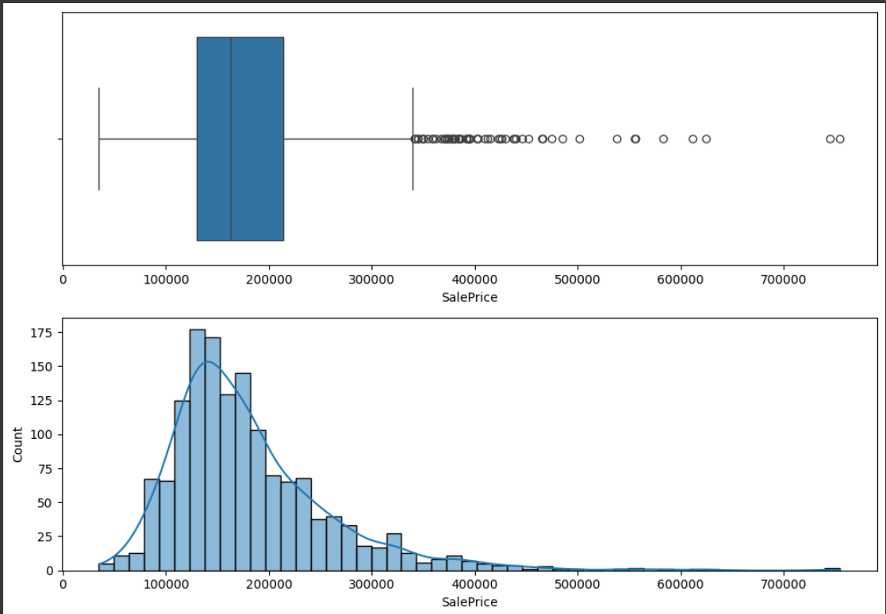
Data Exploration and Visualization

Slide 8
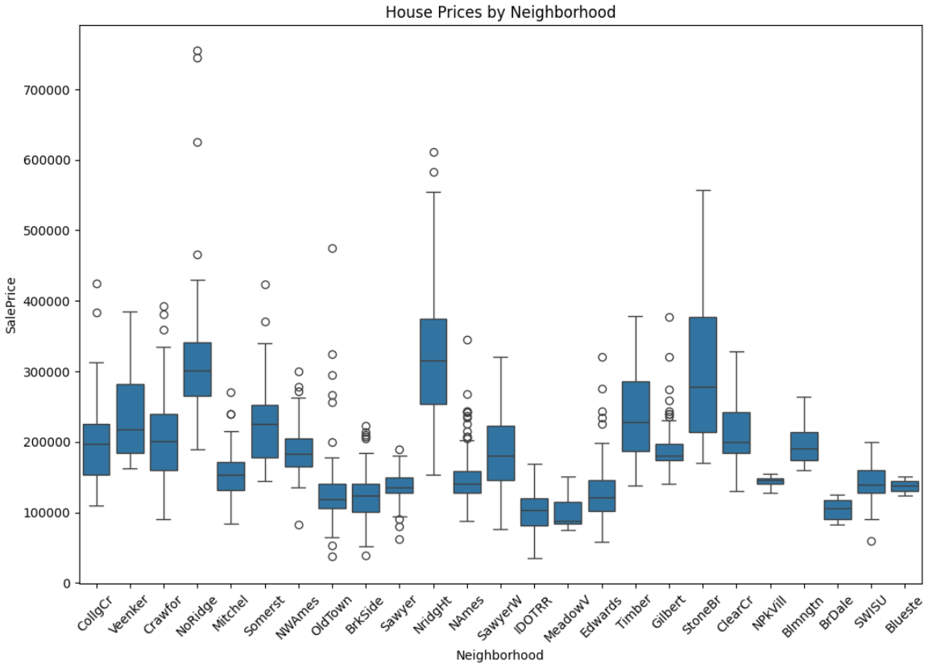
Data Exploration and Visualization

Slide 9
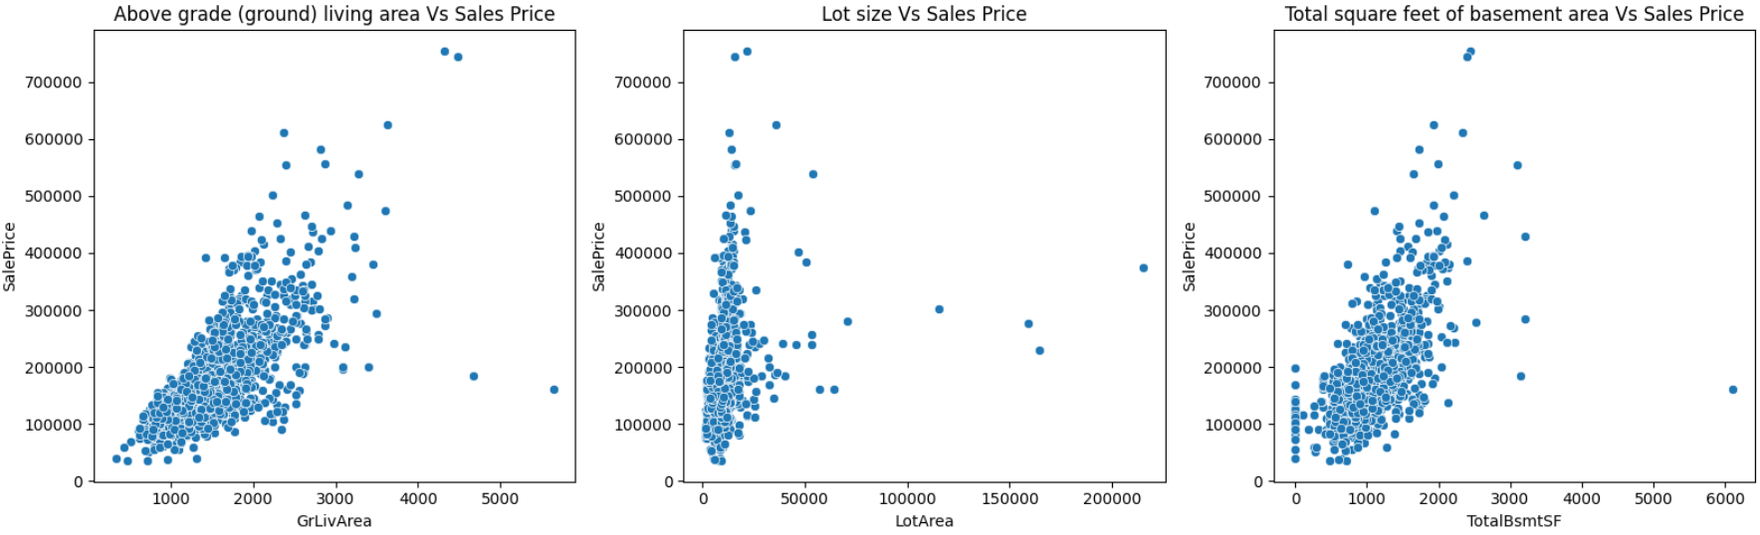
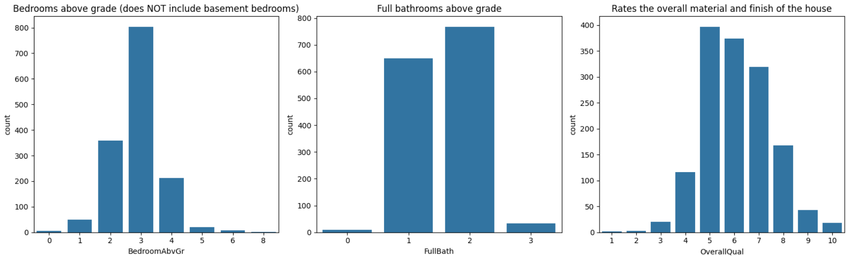
Data Exploration and Visualization

Slide 10

Tools / Analysis
Pandas
Matplotlib and Seaborn
Scikit-learn
Tensorflow and keras
Adam Optimizer
Data Preprocessing
Standardization

Slide 11
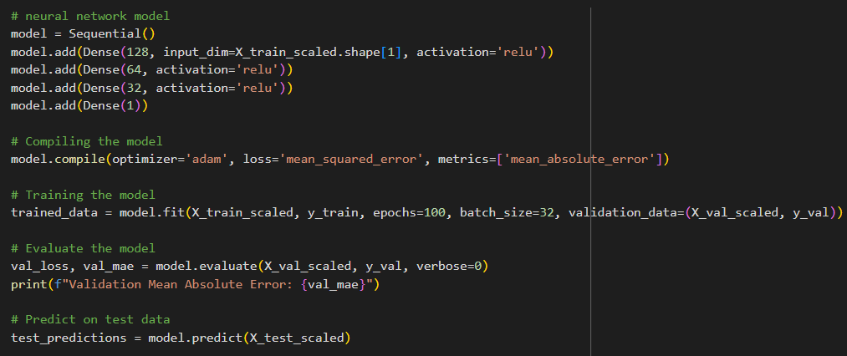
Model Training and Evaluation

Slide 12

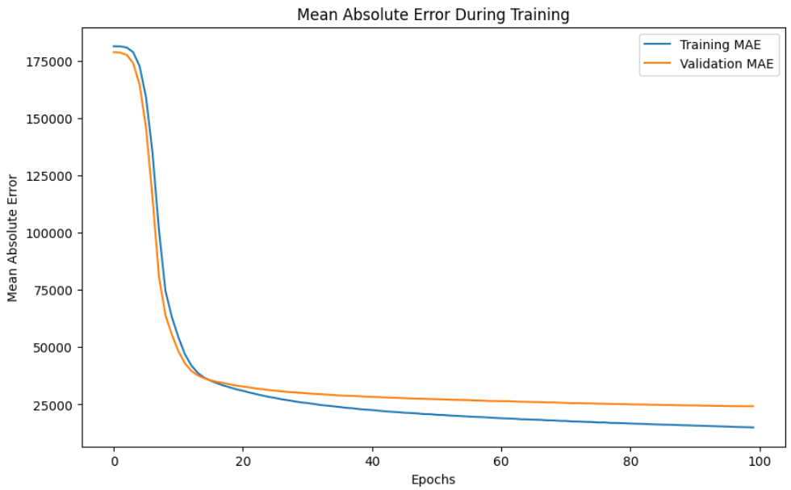
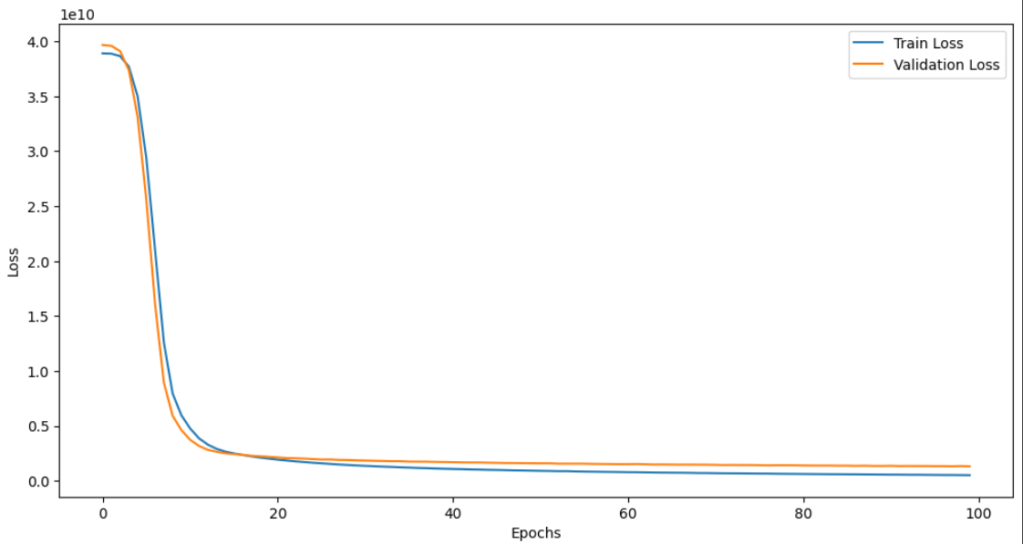
Results

Slide 13
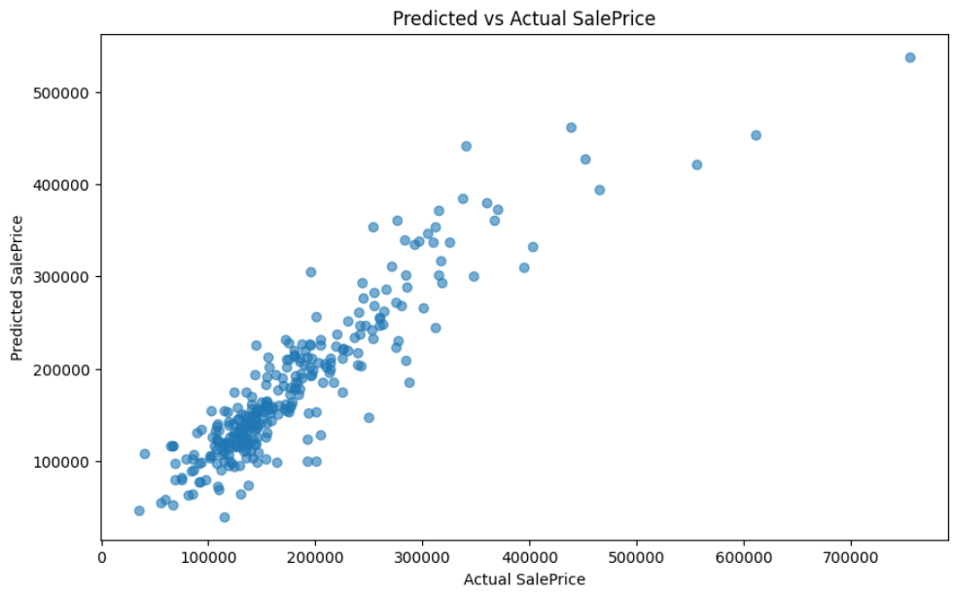
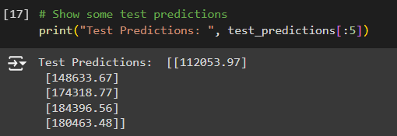
Results

Slide 14
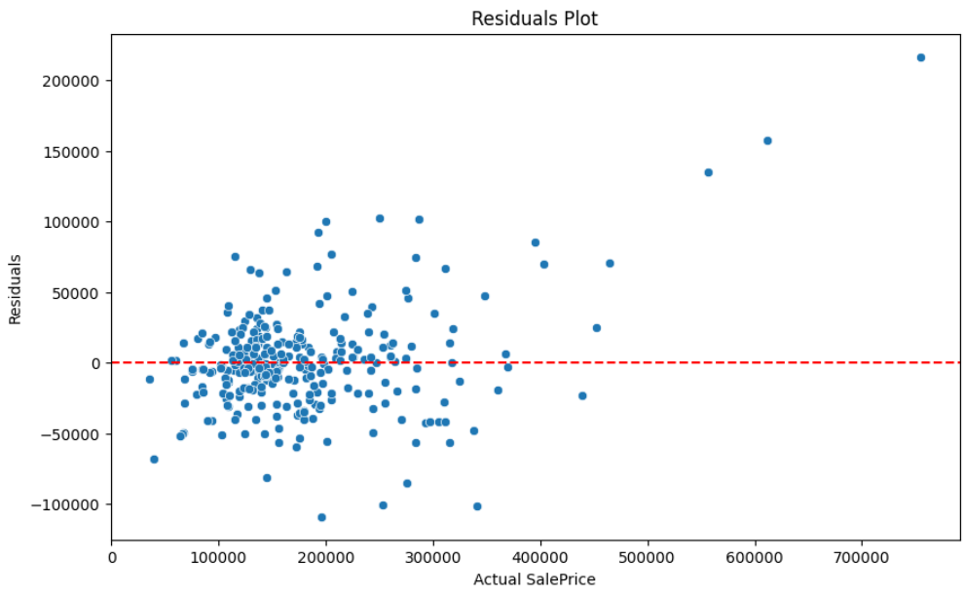
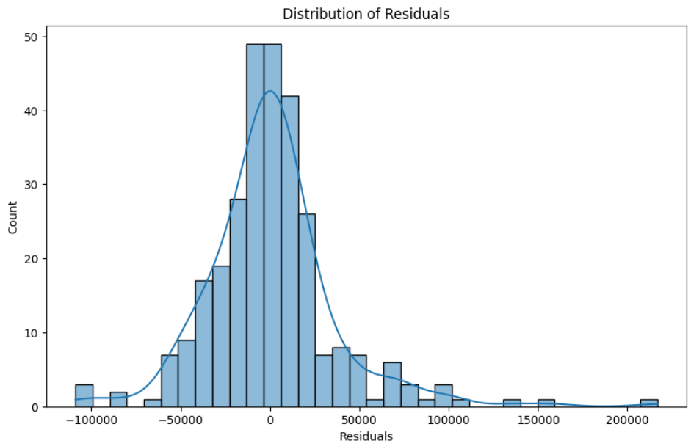
Results

Slide 15
Conclusion
Section -- Literature Review
Validated by demonstrating practical application of neural network model on a house prices dataset and predicting the sales price
Section – Methodology
Well structured approach of preprocessing, training, evaluation and reliability
Section – Analysis
Model’s performance using learning curves, validation MAE, residual plots
Comprehensive solution that uses machine learning tools and techniques to predict target variable and contributing to more efficient and effective business operations.

Slide 16
References
The New York Times. (2024, May 11). Should you put money into a house you’re planning to sell? Retrieved from https://www.nytimes.com/2024/05/11/realestate/should-you-put-money-into-a-house-youre-planning-to-sell.html?searchResultPosition=8
Academia.edu. (n.d.). House price prediction. Retrieved from https://www.academia.edu/38358601/House_Price_Prediction
Meer, M. A. (n.d.). Real estate market analysis. Medium. Retrieved from https://medium.com/@MAMeer841/real-estate-market-analysis-ddc8e21667b3
Singh, L. (n.d.). House price prediction: A data science project guide. Medium. Retrieved from https://medium.com/@laxmisingh7690/house-price-prediction-data-science-project-guide-1-3eca38c9fea2
The Economist. (2020, February 15). Technology is poised to upend America’s property market. Retrieved from https://www.economist.com/finance-and-economics/2020/02/15/technology-is-poised-to-upend-americas-property-market
Stack Overflow. (2019, January 30). How can I add new category in a categorical variable after a qcut? Retrieved from https://stackoverflow.com/questions/54422643/how-can-i-add-new-category-in-a-categorical-variables-after-a-qcut

Slide 17
Thank You

